Slide 1

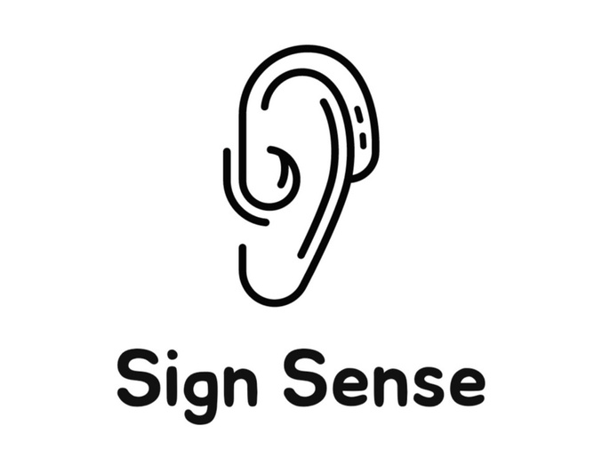
SIGN SENSE
Learn the language of hands !!!

Slide 2


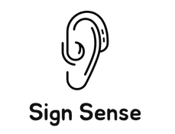
Project Outline
PROBLEM STATEMENT
Individuals with hearing impairments face communication barriers in daily interactions, hindering social inclusion and access to information, necessitating innovative solutions for seamless and effective communication.
AIM
Developing a real-time web application using computer vision & ML to detect and transcribe sign language gestures, empowering the deaf community with seamless communication through instant text translation.

Slide 3
Index
Team Introduction
Objective​
Abstract​
Business Use Cases​
Most Important Use Cases​
Concepts Used​
Our Data Collection Process​
How we Processed our Data​
Model Comparison​
Algorithm Used​
Challenges Faced​
Our Learnings​
Future Enhancements​
Demo​
Conclusion​

Slide 4
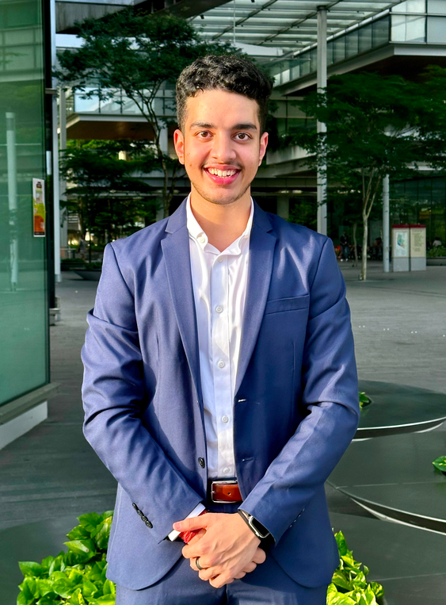

Profile
Aryan Sehgal
MODEL BUILDING
(+DATA COLLECTION)
FRONT END
(+DATA PREPROCESSING )
MODEL BUILDING
(+Data Collection)
FRONT END(+TEMPLATE DESIGNING)
BACKEND INTEGRATION
+DATA COLLECTION
BUISINESS USECASE (+TEMPLATE DESIGNING)

Slide 5


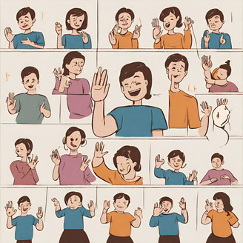



Objective
Model

Slide 6
ABSTRACT
Communication Challenges for Hearing-Impaired Individuals:
Individuals with hearing impairments face daily communication challenges, leading to social exclusion and limited access to information. Recognizing this issue as a significant barrier, the project aims to address and overcome these challenges.
The project focuses on the development of a real-time web application. By integrating computer vision and machine learning, the application will detect and transcribe sign language gestures. The ultimate goal is to provide the deaf community with instant text translation, facilitating seamless communication in real-world scenarios.
Development of Real-Time Web Application:
Empowering Deaf Community Through Innovation:
Through the deployment of innovative technologies, such as computer vision and machine learning, the project seeks to empower the deaf community.

Slide 7
Business Use Cases
Education Platforms for the Deaf: Integrate the sign language recognition technology into online education platforms. This allows deaf students to engage in real-time communication with teachers and peers, fostering an inclusive learning environment.
Public Transport Announcements: Utilize the technology to transcribe sign language gestures for public transport announcements. This ensures that individuals with hearing impairments have access to critical information during their daily commutes.​
Corporate Inclusion Initiatives: Implement the sign language recognition technology in corporate settings to support inclusion initiatives. Enable seamless communication during meetings and other work-related interactions, promoting a diverse and inclusive workplace.​
International Communication: Extend the application for international use, providing real-time translation of various sign languages. This promotes inclusivity on a global scale, allowing individuals from different regions to communicate seamlessly through sign language.​

Slide 8

Most Important Use Cases
Inclusive Learning: The app can be used in educational settings to provide real-time transcription of sign language during lectures, ensuring that deaf or hard-of-hearing students have equal access to information.
Deaf-Hearing Communication: Facilitate communication between deaf and hearing individuals by transcribing sign language into text, enabling seamless conversation in various environments.
Meetings and Conferences: Enhance participation of deaf or hard-of-hearing employees in meetings and conferences by providing real-time transcription of sign language, ensuring they can actively engage in workplace discussions.
Concerts and Performances: Enable deaf or hard-of-hearing individuals to enjoy live performances by transcribing sign language used by performers or speakers in real time.
Emergency Services: Improve communication between emergency responders and individuals who are deaf or hard of hearing during emergencies by transcribing sign language to text.

Slide 9
Concepts Used
Data Collection
Keypoint extraction Computer vision Machine Learning
User Interface design(UI)
LSTM (RNN)
Model evaluation and fine-tuning
Real-time text generation
TensorBoard
Deployment

Slide 10
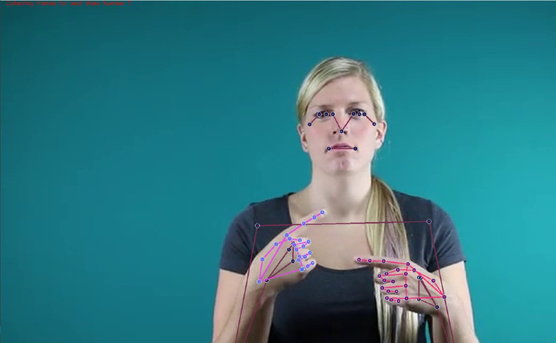
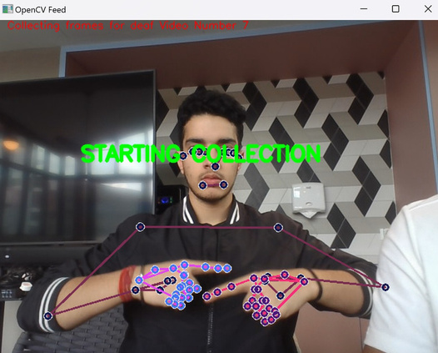
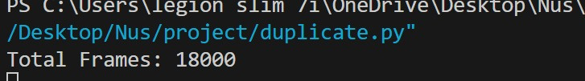
Our Data

Slide 11
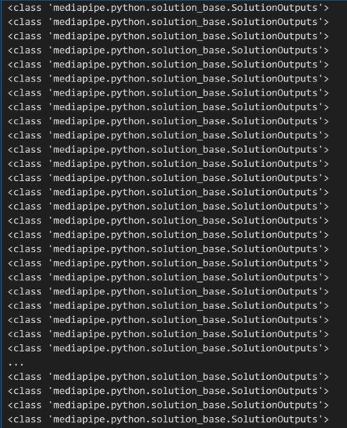
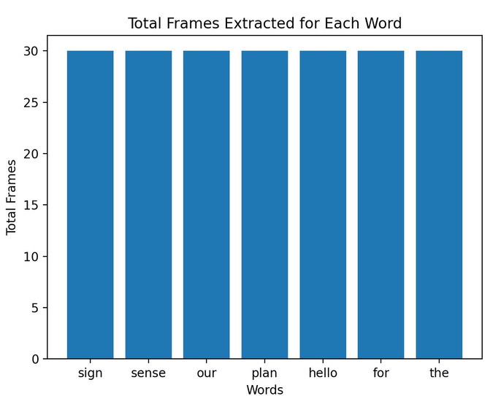
Our Data

Slide 12
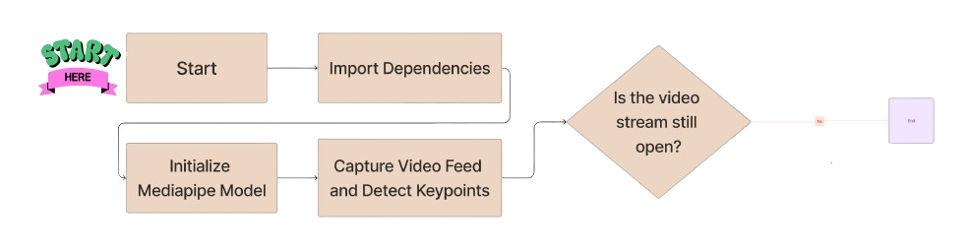
Flowchart

Slide 13
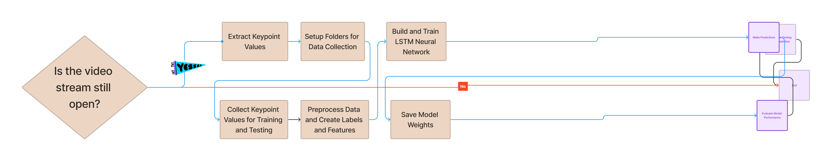
Flowchart

Slide 14
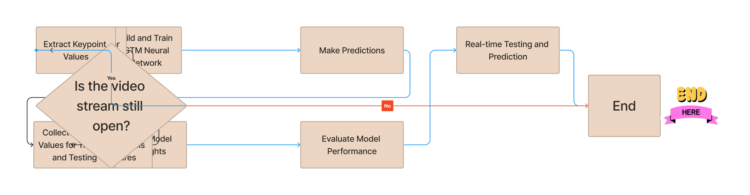
Flowchart

Slide 15
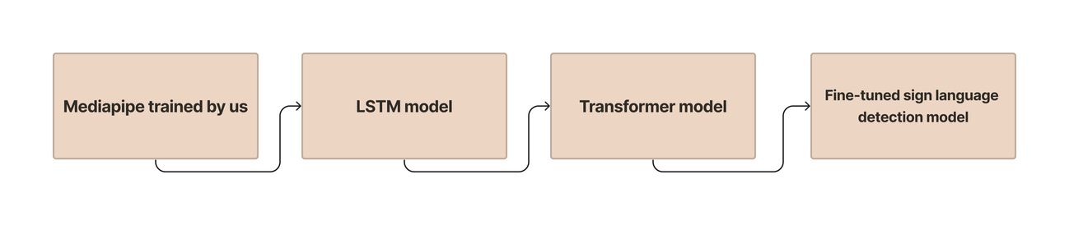
Algorithms Used

Slide 16

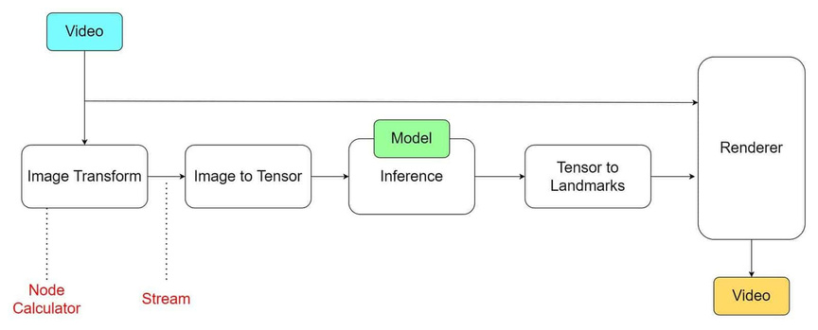
MediaPipe
MediaPipe is an open-source framework for building pipelines to perform computer vision inference over arbitrary sensory data such as video or audio.

Slide 17
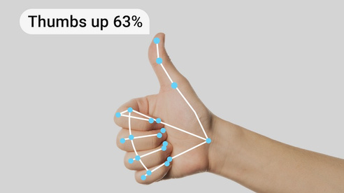
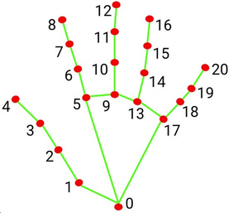
MediaPipe
It lets you recognize hand gestures in real-time and provides the
recognized hand gesture results along with the landmarks of the detected hands.

Slide 18
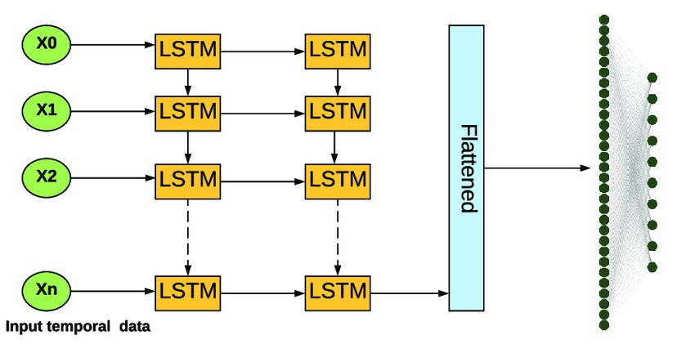
LSTM

Slide 19
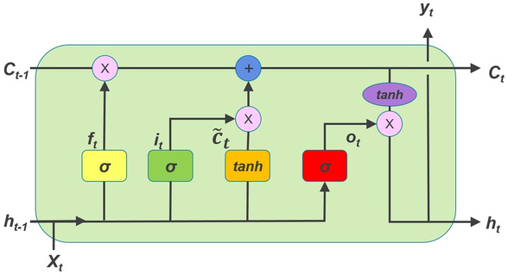
LSTM
• The architecture consists of memory cells and gates controlling the information flow within the network.
• Memory cells allow LSTMs to retain information for longer periods, effectively capturing dependencies across extensive sequences.

Slide 20
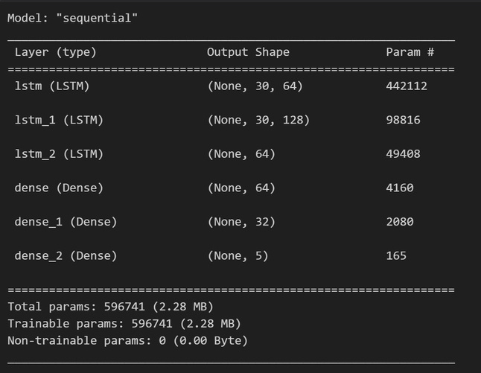
LSTM

Slide 21

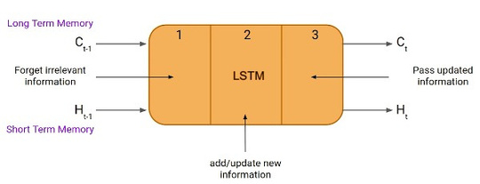
Why we are using LSTM ?
In summary, LSTM is chosen in this context because it is well-suited for handling sequential data with long-term dependencies, which is essential for gesture recognition. The comparison
with other algorithms is task-dependent, but LSTMs are often preferred for sequential data tasks due to their ability to capture temporal patterns effectively.

Slide 22

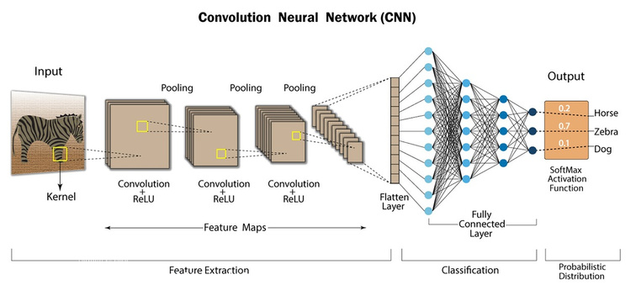
CNN
CNNs are a class of Deep Neural Networks that can recognize and classify particular features from images and are widely used for analyzing visual images. Their applications range from image and video recognition, image classification, medical image analysis, computer vision and natural language processing.

Slide 23
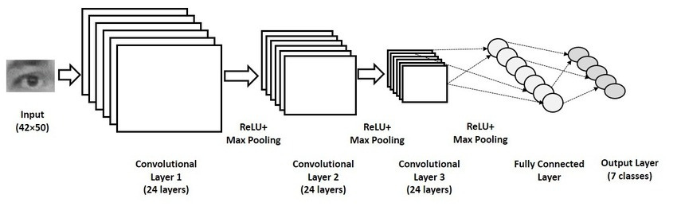
CNN

Slide 24
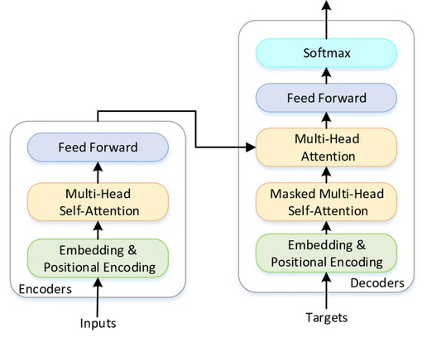
Transformer Model
The Transformer architecture uses an encoder-decoder structure that does not rely on recurrence and convolutions to generate an output. The encoder maps an input sequence to a series of continuous representations.
Transformer models work by processing input data, which can be sequences of tokens or other structured data, through a series
of layers that contain self- attention mechanisms and feedforward neural networks.

Slide 25
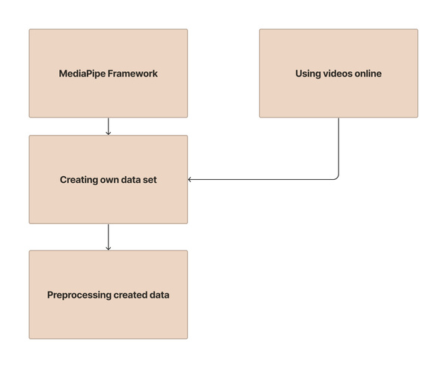
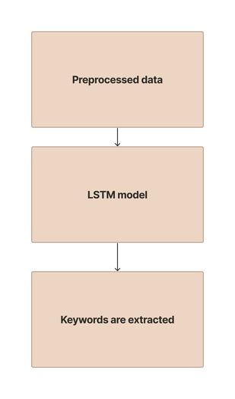
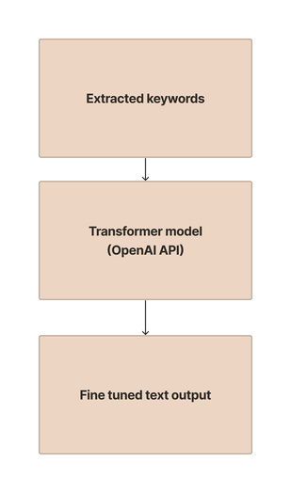
Fine-tuned sign language detection model
Step 1:
Step 2:
Step 3:

Slide 26
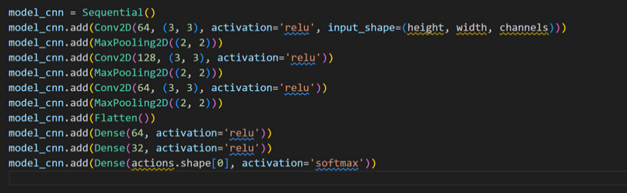
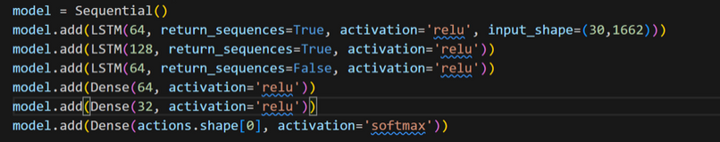
Comparison of models
LSTM
CNN

Slide 27
Comparison of models
LSTM Model
1. Real-time Sign Language Detection:
- LSTM is well-suited for real-time applications, including sign language detection, as it can process sequential data efficiently.
- Its ability to capture temporal dependencies makes it suitable for interpreting gestures over time, which is crucial for real-time applications.
2. High Accuracy
- LSTM models, with their memory cells and ability to capture long-term dependencies, are effective in accurately recognizing complex patterns in sequential data.
- In sign language, where the order and timing of gestures matter, LSTM's ability to remember relevant context helps achieve high accuracy.
CNN Model
1. Real-time Sign Language Detection
- While CNNs are powerful for image data, they may not capture temporal dependencies as effectively as LSTMs.
- Real-time gesture detection might be challenging as CNNs are primarily designed for spatial features and may not handle dynamic changes in gestures as well as LSTMs.
2. Accuracy
- CNNs excel in capturing spatial features, making them effective for static image recognition. However, for dynamic gestures with temporal dependencies, they may not be as accurate as LSTMs.

Slide 28
Comparison of models
Conclusion
For real-time sign language detection, especially when considering dynamic and temporal aspects of gestures, the LSTM model is more appropriate.
- The LSTM's sequential processing capability and memory retention make it well-suited for capturing the nuances of sign language gestures, resulting in high accuracy in real-time scenarios.

Slide 29
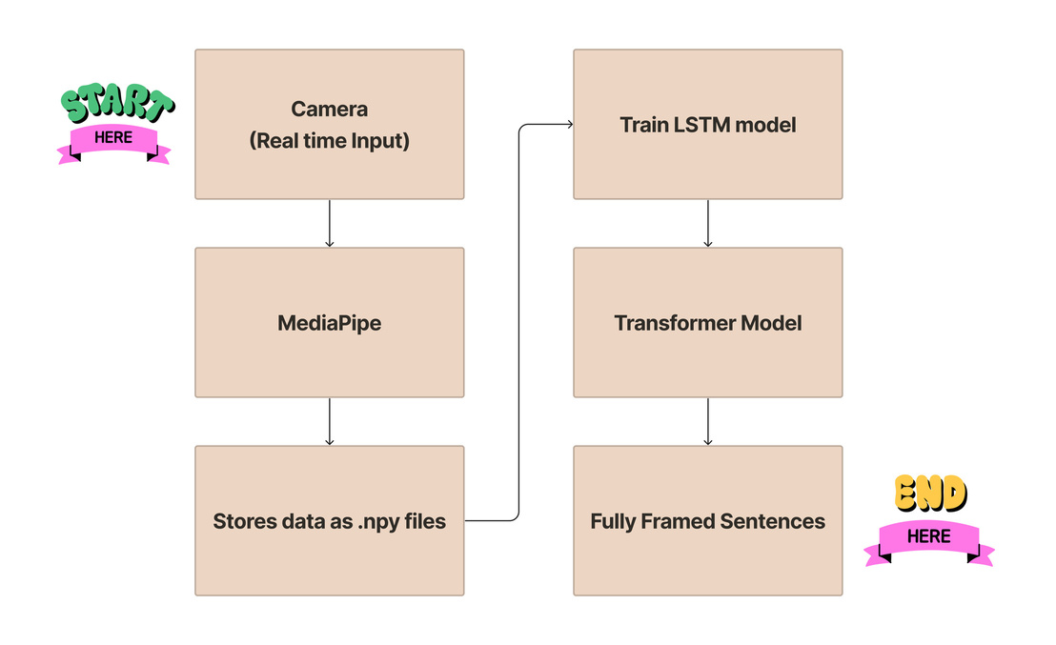
Final Work Flow

Slide 30
CHALLENGES FACED
Addressing the diversity of sign languages poses a significant challenge. Different regions and communities often have distinct sign languages, requiring the system to be adaptable and capable of recognizing various gestures and expressions.
Achieving real-time processing for sign language recognition introduces technical challenges, especially when implementing the system in web applications. Minimizing latency is crucial for providing instant translation and ensuring a seamless communication experience.
Sign language includes nuanced and context-dependent gestures, leading to potential ambiguity. Developing algorithms that accurately interpret the subtle variations in signs and differentiate between similar gestures is a complex task.
Diversity of Sign Languages
Real-Time Processing and La﻿tency
Ambiguity in Gestures﻿

Slide 31
LEARNINGS
Grasping Sign Language Gestures: Understanding the nuances of sign language gestures and how they correlate with the key points detected by MediaPipe.
Data Preprocessing Mastery: We learnt the ins and outs of data preprocessing, ensuring the keypoints are meticulously cleaned, normalized, and formatted to be fed into the LSTM model.
Model Evaluation Skills: Our focus on assessing the accuracy, precision, and recall of our LSTM model in translating sign language gestures into words, utilizing techniques like cross-validation and diverse dataset testing.

Slide 32
FUTURE ENHANCEMENT
Multilingual Support: Expand the system's capabilities to recognize and interpret a broader range of sign languages, addressing the linguistic diversity within the global deaf community. Incorporate machine learning models that can adapt to new languages with sufficient training data.
Gesture Personalization: Introduce features that allow users to personalize the system according to their unique signing styles and preferences. This could involve creating user profiles that adapt the recognition algorithms to individual nuances, enhancing overall accuracy.
Integration with Wearable Technology: Explore the integration of the sign language recognition system with wearable devices, such as smart glasses or wristbands. This would offer users a more seamless and portable communication experience, particularly in situations where traditional devices may be cumbersome.

Slide 33
Demo

Slide 34
Conclusion
In conclusion, the development and implementation of the real-time sign language recognition system mark a significant stride toward fostering inclusivity and effective communication for individuals with hearing impairments. Throughout this journey, our project team navigated various challenges, gained valuable insights, and celebrated successes that collectively contributed to the project's impact.

